Slide 1
Embedded programming
This lesson will show you:
What is embedded system?
How many roles of embedded job? How about them?
What knowledge I need to prepare for embedded job?

Slide 2
Table of contents
      Definition of system
      Definition of embedded system
      Nature of embedded system
      Diffrence from PC
      Example of embedded system (washing machine)
      Fields of an embedded system
      Embedded hardware
      Embedded firmware
      Embedded software
      Diffrences between firmware and embedded software
      What language need for embedded system
      OOP language with embedded system
      Choose language
      Choose microcontroller
      Learning RTOS
      Refer documents
Embedded programming
Le Viet Long

Slide 3
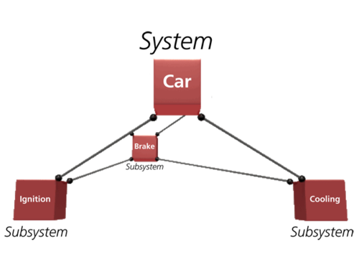
Definition of system
        A system is a group of units that are joined together to work in a specific routine and
    perform some fixed operation.
        These units could be of any nature i.e. if you are working on an electronics system then
    these units will be electronic components.
        Similarly, if you are working on some mechanical system then these units will be
    mechanical equipment or machinery etc.
Embedded programming
Le Viet Long

Slide 4
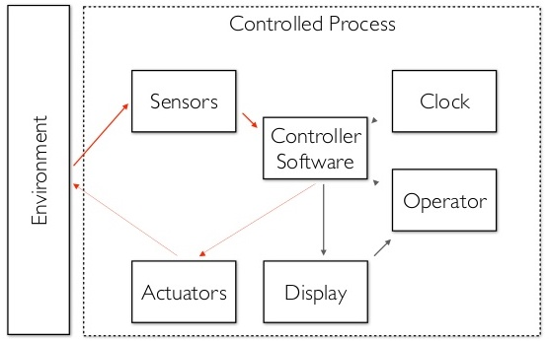
Definition of embedded system
          An embedded system is a Microprocessor or Microcontroller based system of
    hardware and software designed to perform dedicated functions within a larger mechanical or electrical system.
Embedded programming
Le Viet Long

Slide 5
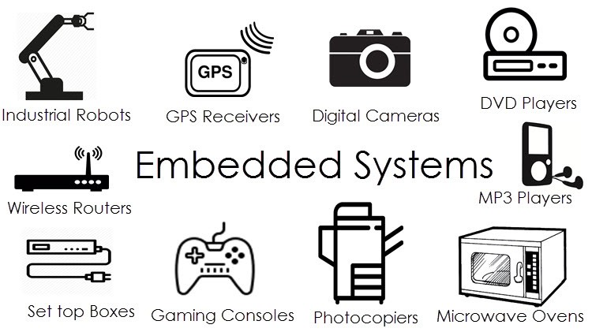
Definition of embedded system
        In simple words, embedded systems perform specific tasks. They have Microcontroller
as the main part which controls all the operations required through them.
        These systems are smart and more efficient, which is increasing their use day by day.
  Almost every device that we use today is an example of embedded systems. Embedded systems examples can be seen at our homes, at offices, in industries and in automation systems.
Embedded programming
Le Viet Long

Slide 6
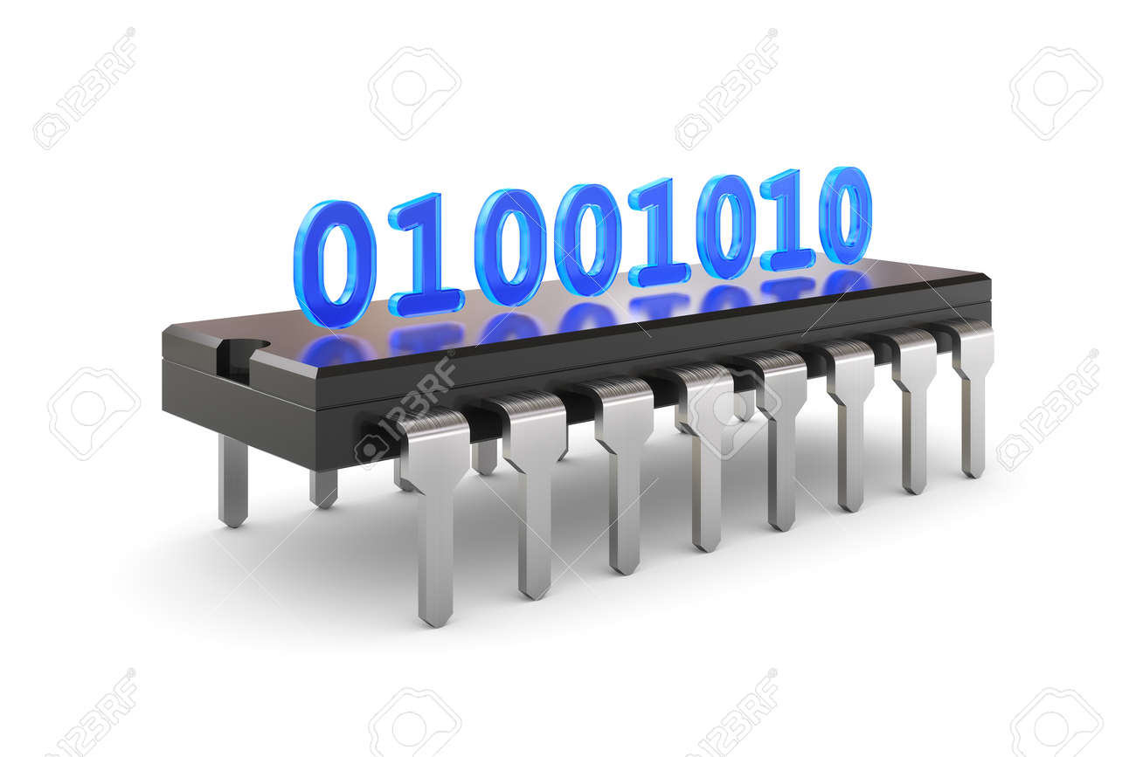
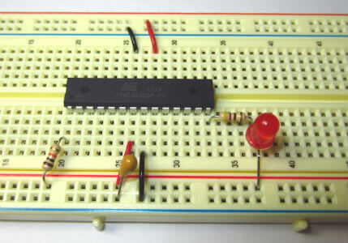
Nature of embedded system
        An embedded system is that system which has computer hardware with software
    embedded in it. (Software has been stored in binary format - object file, i.e: file.hex).
        Notice: It is a device which has a programmable computer (like Microprocessor – MP
    or Microcontroller - MC was built internally) but a computer is not general purpose computer. (I will explain this later).
        As picture below, we push software with binary format to MC (stored in ROM), put it
    in simple circuit (hardware) and do blinking led.
Embedded programming
Le Viet Long

Slide 7
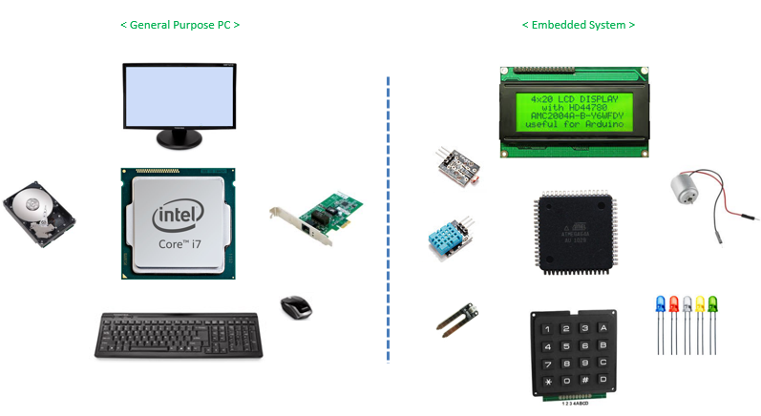
Diffrence from PC
        A general purpose computer such as PC is not an embedded system as it does not
    perform only specific functions. It can be used for a number of applications. Different programs can be installed on a PC for different tasks. A PC has a RAM and an operating system. The operating system loads application software into RAM and then the CPU runs it.
        While in the case of an embedded system, there is ROM in which application software
    is burned which can usually perform only one task.
Embedded programming
Le Viet Long

Slide 8
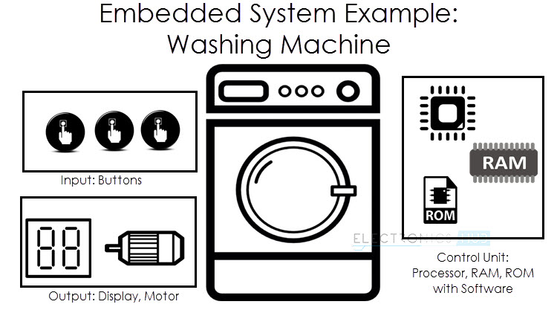
Example of embedded systems
      Take a look to automatic washing machine:
    You just have to add clothes and leave it to the machine. Rest operations are done by your machine itself.
    Machines have a Microcontroller for controlling all the tasks. Sensors and actuators in this case are level sensors, valves, motor and also a display and keypad to input information.
    Once you load clothes in machine, the whole process consists of three cycles. washing, rinsing and spinning.
Embedded programming
Le Viet Long

Slide 9
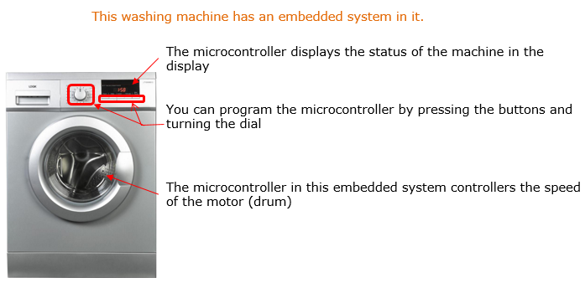
Example of embedded systems
    During washing and rinsing cycle, water is added to the drum by pipes.
    Closing and opening of valves for adding water is checked through level sensors
    Then the rotation of drum starts for pre-set time. After that water is drained out through pipes.
    During spinning cycle, water is not added and drum rotates for a set time.
    The timings for each cycle can be changed through the keypad.
Embedded programming
Le Viet Long

Slide 10
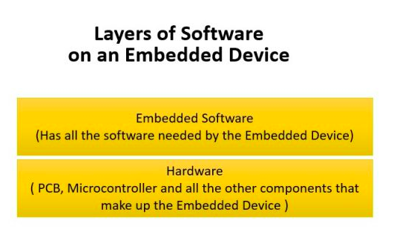
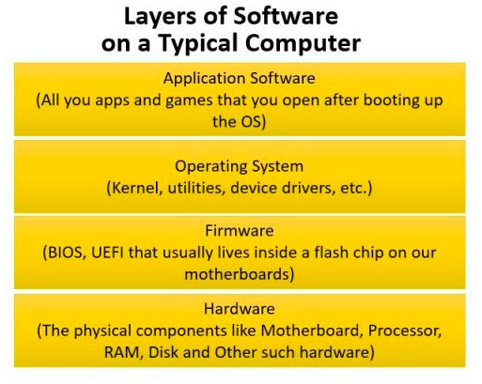
Fields of an embedded system
    Embedded system appear normally in two kind of system: special purpose computer and general purpose computer (you can see their layer graph below)
Embedded programming
Le Viet Long

Slide 11
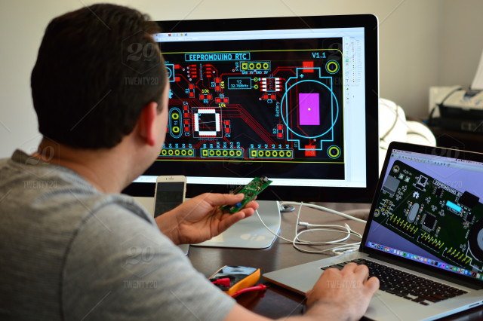
Embedded hardware
    Embedded hardware works:
    Electronic circuit design
    PCB layout design
    Debugging PCB
    Supporting firmware developers
    Etc...
    In this article, I have concentrated to Embedded programming so I will not say much about this role. But remember that, hardware experience is very important for an embedded engineer. Doing works at low level with hardware without knowledge about basic electronics or PCB is really a nightmare. It so hard to do your work if hardware engineer give you a PCB while you can’t read them or use them.
Embedded programming
Le Viet Long

Slide 12
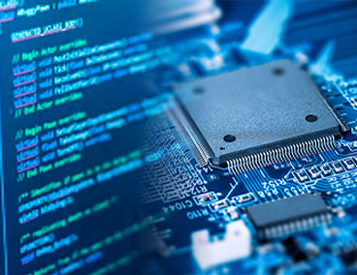
Embedded firmware
  “firmware” was software that was stored in a special type of memory chip called an EPROM(erasable programmable read-only memory), or an EEPROM, the “electrically erasable” version. These chips were distinguished from garden-variety ROM chips. They could be erased and reprogrammed;
  Firmware is typically used as low-level software that operates a specific, single-purpose device. Many components within a personal computer – video adapters, disk drives, and network adapters – have firmware, as do many peripherals that connect to computers (printers, external storage devices; peripherals…).
Embedded programming
Le Viet Long

Slide 13
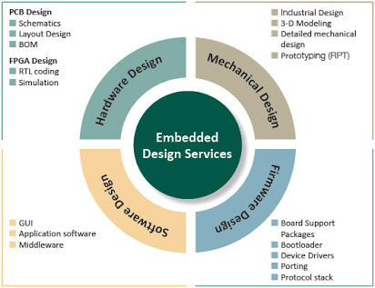
Embedded software
Like firmware, embedded software is software designed for a particular device. It typically runs on a Microcontroller or microprocessor onboard the device.
But unlike firmware, embedded software operates more like application on computer. Embedded software typically implements higher-level features and functions of the device. Firmware takes care of low-level tasks such as converting analog sensor signals to digital data and managing communications protocols.
Embedded software can be highly sophisticated, and is often written in high-level languages such as C++, Java, JavaScript, or Python. Many modern devices there is an operating system involved, such as Android or Linux.
Embedded programming
Le Viet Long

Slide 14
Diffrences?
These days, there’s no real bright-line distinction between the two types of those software. Depending on the device’s design, some tasks traditionally relegated to one may be handled by the other. For example, on a printer, firmware take care of printing, communication with computer, even communication with phone to print document. It works like a controlling software. So it can be called as either “firmware” or “software” .
But in some complicated device, we can see some distinct differences between them: for example: Smart TVs still have firmware for the low-level signal processing tasks, and more firmware to operate the wired or wireless network interface and communications with the remote control (which also now has firmware). But smart TVs also have operating systems; usually, Android or Roku, as well as apps that are preinstalled on the TV or that can be downloaded from the internet. These apps—the embedded software—enable a higher level of user interactivity beyond changing the channel and adjusting the volume.
Embedded programming
Le Viet Long

Slide 15
What’s language need for embedded?
    C language
    Nowadays, many languages was born, but no one can replace C position in embedded because of these reason:
        Processor independent: C language is not specific to any microprocessor/micro-controller or any system. It can work on various hardware configuration. C doesn’t require same set of hardware to run a program
        Portability: Code developed in C is more portable and user can compile it on other platforms with least modifications. C code is efficient, easy to understand, maintain and debug. A program can be written in one machine and can be run on other machines.
        Performance: C code gets compiled into raw binary executable which can be directly loaded into memory and executed. C provides optimized machine instructions for the given input, which increases the performance of the embedded system. Most of the high-level languages like: python or C++ rely on libraries, hence they require more memory which is a major challenge in embedded systems.
Embedded programming
Le Viet Long

Slide 16
What’s language need for embedded?
      Memory management: It provides direct memory control without sacrificing benefits of high-level languages. We can directly access memory using pointers and perform various operations using them. When memory requirement is not known, we can allocate it dynamically and when memory requirement is known, we can allocate the memory statically. This is one of the main reasons for why is C the most preferred language for embedded systems.
      Bit manipulation: C is more flexible, structured language that provides “low level bit wise data manipulation” using the bit-wise operators. Using bit-wise operators, one could play with available bits, which comes handy when it comes to Embedded Systems (Ex: Handling registers).
Embedded programming
Le Viet Long

Slide 17
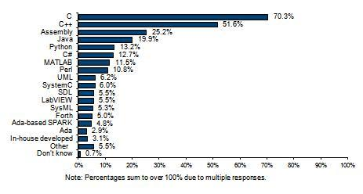
OOP language with embedded system
    But in nowadays, modern C++, Python compiler has been supported so much. Development environment, modern compilers and their optimizers are very good. Also memory has become bigger, processor has become stronger. Therefore, in some modern application, using modern object oriented programming techniques has been useful for high level features of embedded systems.
    You can see the graph below, it arrange popularity of programming languages that was used in embedded system
Embedded programming
Le Viet Long

Slide 18
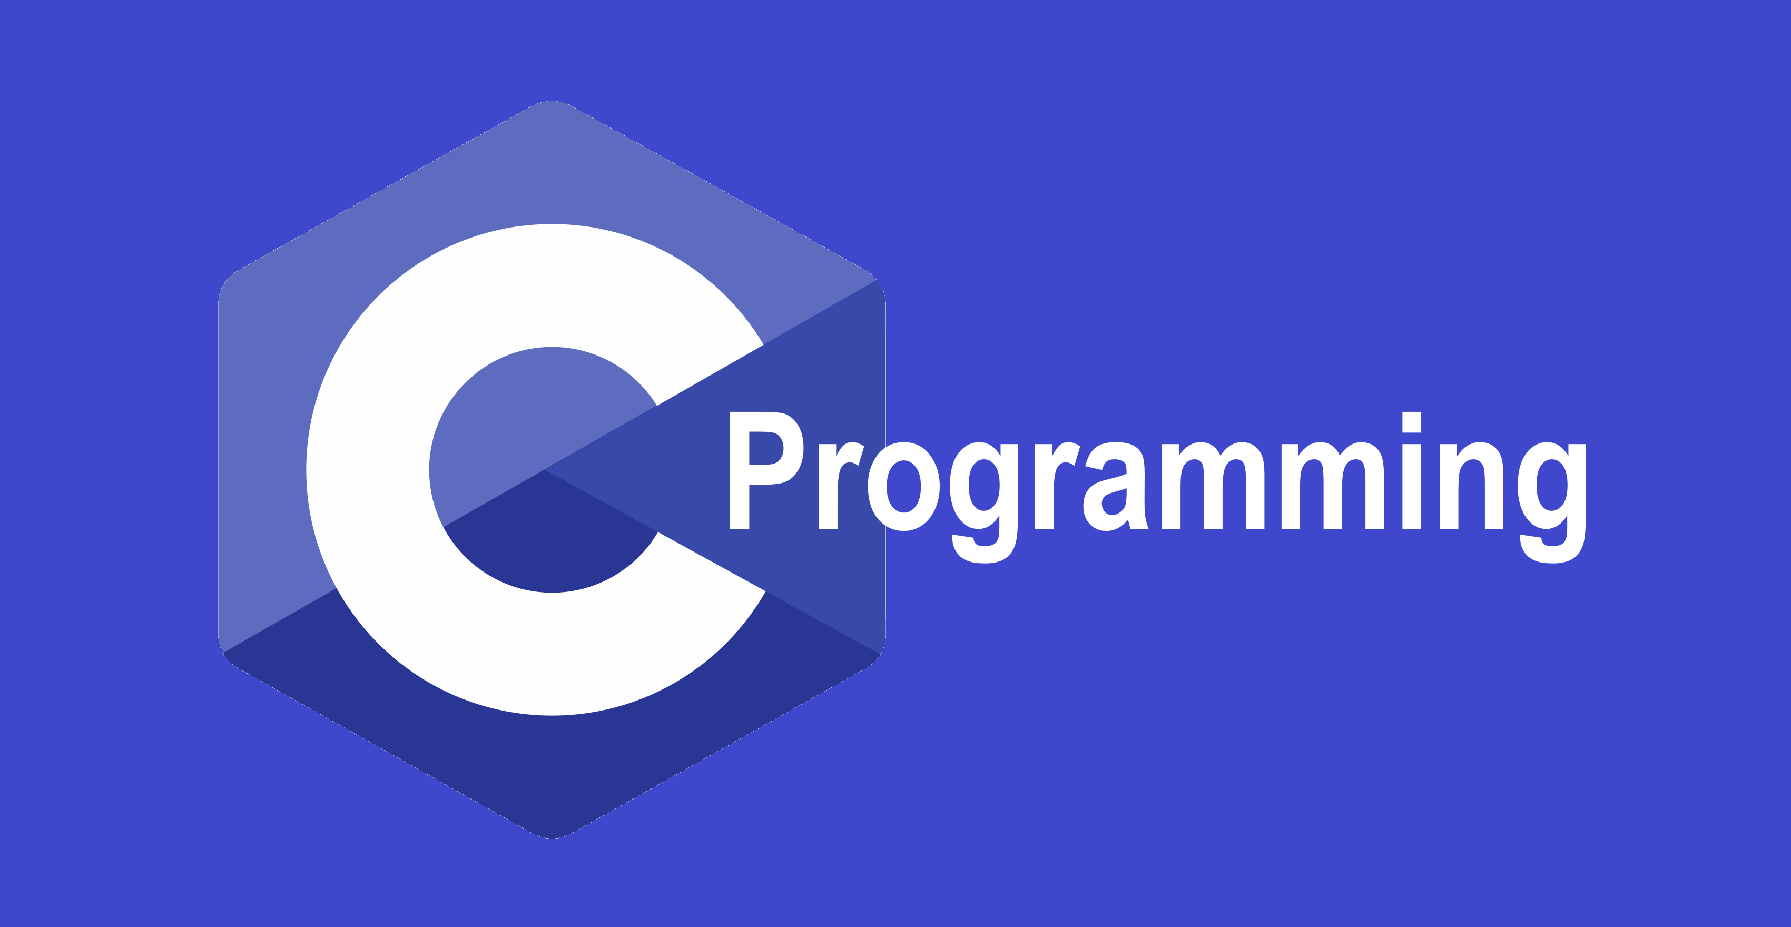
Choose language
Now that you have an idea about embedded systems, so let's take a step forward and learn Embedded system.
      Choose programming language: Embedded Systems can be programmed using both low level programming languages and high level programming language. For a complex system, the user has more control if using low level language like Assembly. Small system , you can use high level language like C. You also can use C++/Python to make high level features for modern system (normally, it is used alongside with C / assembly)
      As a newbie, I suggest you learn C. I also teach you this language is this course.
Embedded programming
Le Viet Long

Slide 19
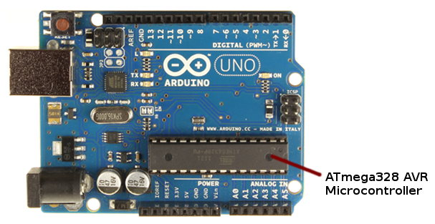
Choose Microcontroller
      Know your Microcontroller: Microcontroller or microprocessor is the very important part of embedded system. So the second thing that you should know is your microcontroller. A microcontroller will act as a CPU of your embedded system. It has RAM, ROM and some other peripherals such as timers, counters etc. Most commonly used microcontrollers are Arduino, AVR, PIC or 8051, ARM etc.
      I suggest you learn AVR 8bit or ARM 32 bit like STM32. Arduino may be easy for beginner, but you can’t understand deeply if using that “libraryful” board. Because Arduino based on AVR microchip, so I will teach you AVR in this course.
Embedded programming
Le Viet Long

Slide 20
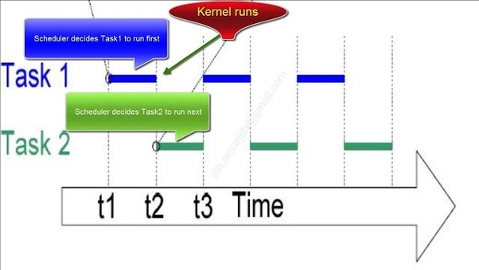
Learning RTOS
      Know how to use a type of RTOS (Real Time operating system) for your Microcontroller
      As the software requirements increase, the main loop gets more complex. When the software requirements are so many that the main loop becomes too complex or cannot fulfill the real-time requirements of the system then it is time to consider another architecture.
      A RTOS architecture allows you to divide the software requirements into tasks. If done properly, this simplifies the implementation of each task. And with task prioritization an RTOS can make it easier to fulfill real-time requirements.
      So I suggest learning
      Free RTOS with STM32
Embedded programming
Le Viet Long

Slide 21
Refer document
https://embeddedinventor.com/firmware-vs-embedded-software-explained-with-examples/
https://www.omnisci.com/technical-glossary/embedded-systems
https://www.theengineeringprojects.com/2016/11/examples-of-embedded-systems.html
https://embeddedinventor.com/firmware-vs-embedded-software-explained-with-examples/
https://www.andplus.com/blog/firmware-vs-embedded-software-what-s-the-difference-
https://www.emertxe.com/c-programming/why-is-c-the-most-preferred-language-for-embedded-systems/#:~:text=C provides optimized machine instructions,major challenge in embedded systems.
Embedded programming
Le Viet Long

